Slide 1

University Institute of Liberal Arts and Humanities
Course Name- Communication Skills
Course Code: 232PCH-105
AGENDA & MINUTES OF MEETING
DISCOVER . LEARN . EMPOWER

Slide 2
COURSE OBJECTIVES
The Course aims to:
1 | Augment students overall communication and interpersonal skills by making them realize the importance of good oral and written English Language in professional life.
2 | Enrich their reading capability with special emphasis on expanding vocabulary and grammatical formations.
3 | Build exceptional speaking, reading and writing skills by correcting grammatical errors and pronunciation through practice.
4 | Enhances soft skills by fostering self awareness, confidence and a positive attitude in students’ ability to communicate effectively in English.

Slide 3
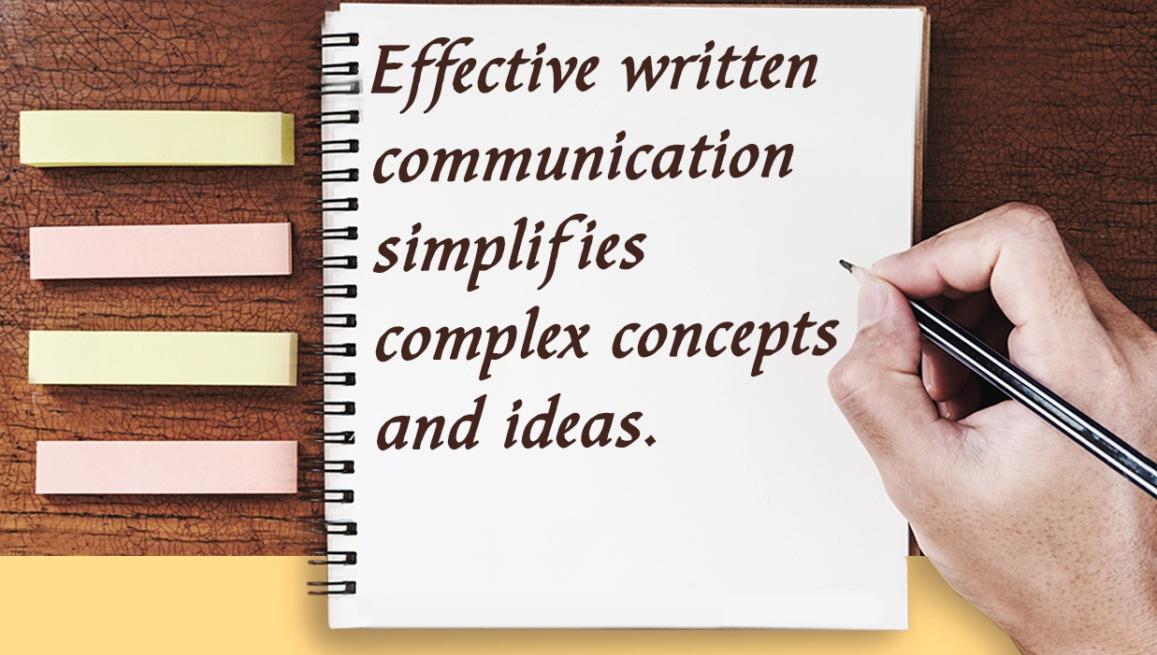
Course Outcomes
On completion, the students are expected to:
CO Number | Title | Level
CO1 | Apply appropriate Listening, Speaking, Reading and Writing Skills (LSRW Skills) with correct non-verbal cues to attain expertise in soft skills. | Apply
CO2 | Apply correct contextual and comprehensible written text in the form of paragraph writing, short compositions business correspondence, using logical support and argument in a wide range of communication situations. | Apply
CO3 | Demonstrate linguistic competence while speaking and during presentations through accuracy in grammatical usage, vocabulary, pronunciation and intonation. | Apply
CO4 | Evaluate information as critical readers, speakers and writers applying ethics in communication and being sensitive in cross cultural communication. | Evaluate
CO5 | Create original, digital content for websites, blogs, vlogs and personal social media profiles etc. | Create
https://penlighten.com

Slide 4
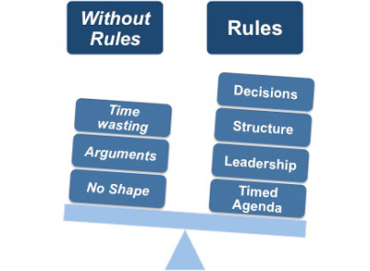
Running Effective Meetings
Meetings
Meetings are an inevitable part of business organizations.
Their success depends on how they are conducted that is
with or without rules.
www.freepik.com

Slide 5

Components of a Meeting
The 3 components which are inextricably linked to team meetings are:
Notice
Agenda
Minutes of the Meeting
http://www.free-management-ebooks.com

Slide 6
What is a Notice?
The statement that contains the particulars of holding a meeting is known as notice. It is one kind of request to the members for attending the meeting.
“ A notice is the communication-verbal or written, informing the persons entitled to attend the meeting about the time, date, place and the business of the meeting.” - S.K. Dutta

Slide 7
Purpose & Prerequisites of Notice
The notice of meeting informs the members when and where the meeting will be.
Every notice of meeting should contain the following contents:
Title/Type of the meeting such as annual general meeting, annual review meeting, board meeting etc.
Date, time and place of the meeting
Agenda for the meeting
Signature of the competent person

Slide 8
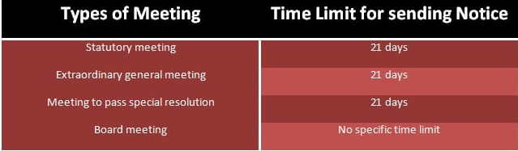
Notice of Meeting-Companies Act
In case of company meetings, the Companies Act provides specific time limit for sending notice to the concerned parties prior to meeting. The Companies Act 2013 defines the minimum time length for sending notice prior to meeting:
https://thebusinesscommunication.com

Slide 9
Poll Question 1
Which out of these is an important component of a Notice?
Address of the organisation
Objective of a meeting
Outcome of a meeting

Slide 10
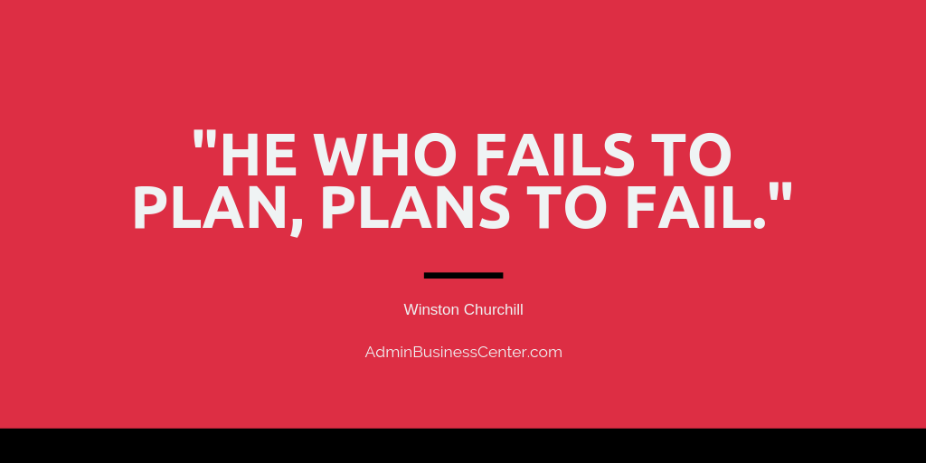
Agenda
What is an Agenda?
Agenda is an official list of things to be done or dealt with at a particular meeting.
An agenda is always preceded by a notice.
It is a planning which is essential to be made before a meeting.
https://adminbusinesscenter.com

Slide 11
Importance of Agenda
An agenda is a form of courtesy. It –
informs the chairperson and participants of the purpose of the meeting.
provides them time to prepare for the tasks and make a meaningful contribution.
ensures that only matters relevant to that particular meeting are discussed.
facilitates the preparation of the minutes.

Slide 12
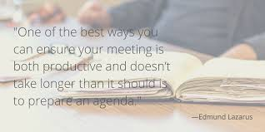
Importance of Agenda - Contd.
It also helps in –
Advance Communication
Fulfilling meeting objective
Engaging the Members
Managing time
https://www.pinterest.co.uk

Slide 13
Essentials of Agenda
In order to increase the meeting productivity, an agenda must be created keeping the following elements in mind:
Objective of the meeting to be written on the agenda clearly.
The meeting work plan/the body of the agenda.
Allocating time, keeping time check, calling the question.
Parking lot feature to be added.

Slide 14
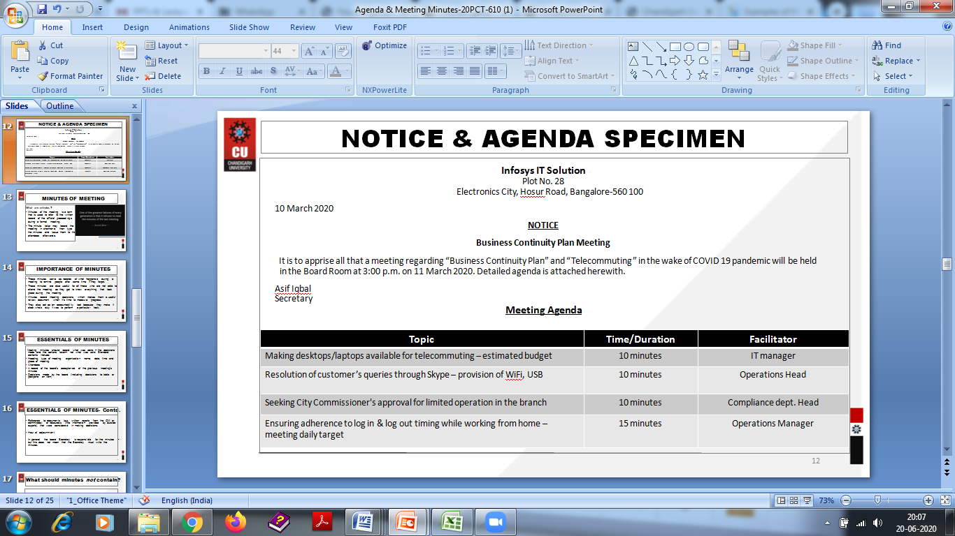
Notice & Agenda Specimen

Slide 15
Poll Question 2
A Notice must accompany an Agenda.
Yes
No

Slide 16
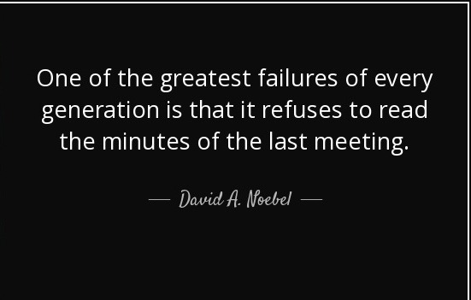
Minutes of Meeting
Minutes of the meeting is a term that is used to refer to the written record of the official proceedings during a formal meeting.
The minute taker may record the meeting in shorthand, then type the minutes and issue them to the attendees afterwards.
https://www.azquotes.com

Slide 17
Importance of Minutes
These minutes:
Serve as records of what happened during a meeting to remind people after some time if they forget.
Are useful for all those who are not able to attend the meeting as they get to know everything that took place during the meeting.
Are a record of meeting decisions, which makes them a useful review document when it’s time to measure progress.
Act as an accountability tool because they make it clear who’s duty it was to perform a particular task.

Slide 18
Essentials of Minutes
Meeting minutes should record what was done – the decisions made and the actions taken– not what was said. Standard contents include:
Heading, type of meeting, organization name, date, time and place of meeting
Attendees
A record of the board’s acceptance of the previous meeting’s minutes
Decisions made by the board (including decisions to table or postpone an item)

Slide 19
Essentials Of Minutes – Contd.
Reference to documents (e.g. written reports from the GM or committees) or resources (like information provided by outside experts) that were considered in making decisions
Hour of adjournment
In general, the board Secretary is responsible for the minutes – but this does not mean that the Secretary must write the minutes

Slide 20
What should Minutes not contain?
A transcript, or details of who said what.
Personal opinions, interpretations or comments: because this sort of information is rarely helpful later, and does not reflect the will of the board as a whole, it is better just to leave it out.

Slide 21
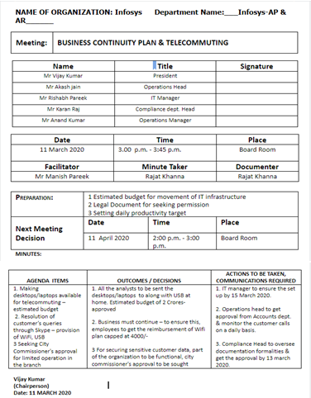
Meeting Minutes Sample

Slide 22
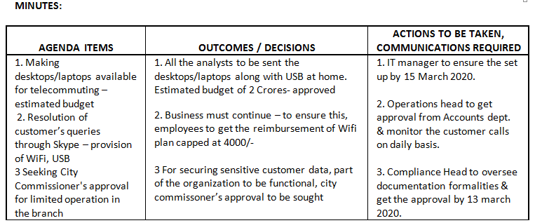
Minutes

Slide 23
Difference Between Agenda & Minutes
Definition
Preparation
Agenda -
is a list of items to be discussed at a formal meeting
Minutes -
the official records of discussions held and decisions taken at a meeting
Agenda -
drawn up by the secretary in consultation with the Chairman.
Minutes -
are generally written by the secretary of the organizational unit.

Slide 24
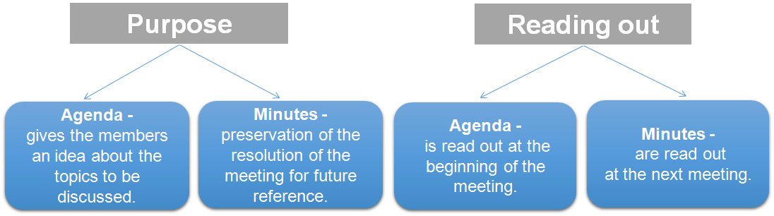
Difference Between Agenda & Minutes – Contd.

Slide 25
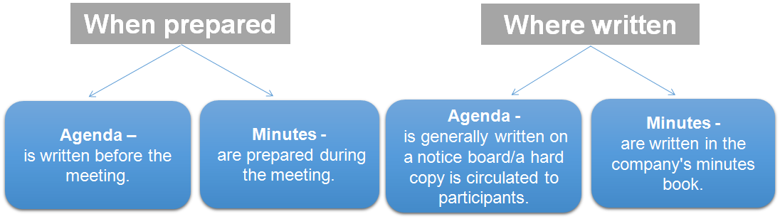
Difference Between Agenda & Minutes – Contd.

Slide 26
Poll Question 3
Minutes of the meeting must contain –
Hour of adjournment
Transcript of discussion at the meeting
Personal opinion about discussion

Slide 27
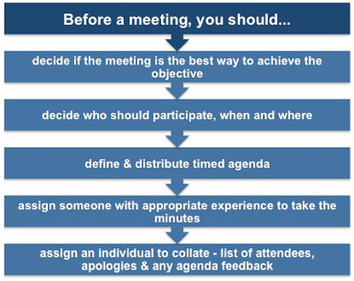
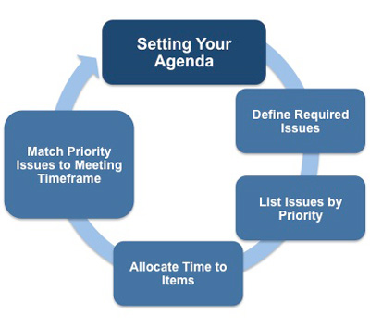
A Quick Recap
http://www.free-management-ebooks.com

Slide 28
Glossary
Call to order
to formally signal the start of a meeting
Committee Reports
progress reports presented at meetings
New Business
Old Business
new topics and issues
unresolved discussions from a previous meeting
Quorum
the number of people needed for a meeting to be legitimate and commence

Slide 29
Applications
Students will be able to explain what an agenda and meeting minutes are and why they are useful.
They will be able to identify the key components of agenda and meeting minutes.
They will be competent to draft agenda and minutes of the meeting in the workplace.
They’ll be equipped with one of the essential job skills – writing.
They’ll be able to demonstrate their ability to explain, summarize and refine ideas.

Slide 30
Assessment Pattern
Students are assessed on the basis of the following parameters:
Hourly Tests - 2
Assignments
Surprise Test
Quiz
Student Engagement
End Semester Exam

Slide 31
References
https://www.simonstapleton.com/wordpress/2012/04/18/10-reasons-why-team-meetings-are-important/
https://bizfluent.com/info-8775163-importance-having-agenda-meetings.html
http://hcrc.revacomm.net/images/BOD/PONO/stop%20wasting%20valuable%20time.pdf
Reference books:
Taking Minutes of Meetings – 5th Edition by Joanna Gutmann
The Art of Taking Minutes Paperback – April 19, 2011 by Delores Dochterman Benson

Slide 32
THANK YOU
For queries
Email: communicationskills.uilah@gmail.com

